Slide 1



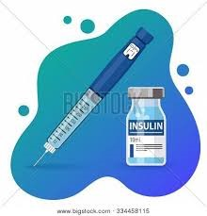
Diabita Application
Founders <Group C4>:
Asmaa Ibrahim
Perryhan Essam
Maha Emad
AbdelMo’men Mostafa
Company Address<20 El Tayran St. ,Nasr City, Cairo>
Date<2021>

Slide 2
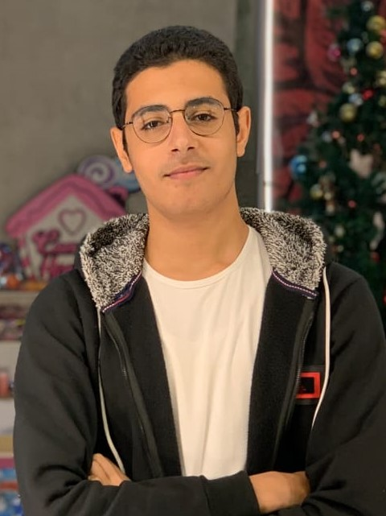
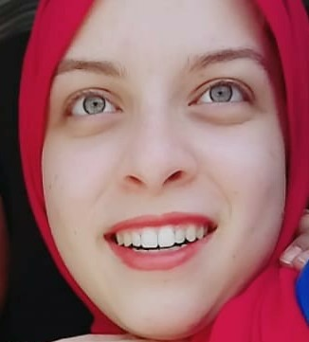
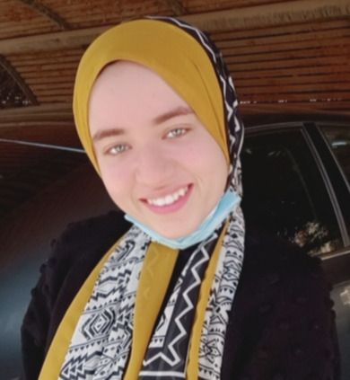
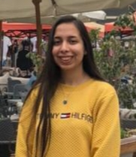
Founders:
Maha Emad
Co-coordinator
mahaemadsaid224@gmail.com
Abdelmo’men Mostafa
Business Person
AbdulMomen20208155@fci.helwan.edu.eg
Asmaa Ibrahim
Coordinator – Designer Person
Asma20208030@fci.helwan.edu.eg
Perryhan Essam
Techie Person
perryhanessam@gmail.com

Slide 3

The Problem

Slide 4
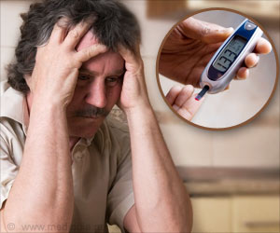
Diabetics problem:
Diabitics suffer from regulating their life style as diabitis have a controling nature over the patient

Slide 5
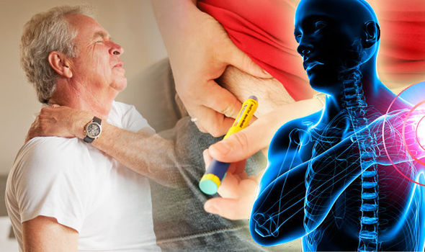
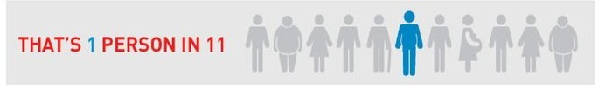
More than 65% from the diabetics in Egypt can’t handle their disease and make control over it .
Statistics shows that 25% to 50% of them goes into diabetic distress due to the lake of support and awareness about diabetes

Slide 6
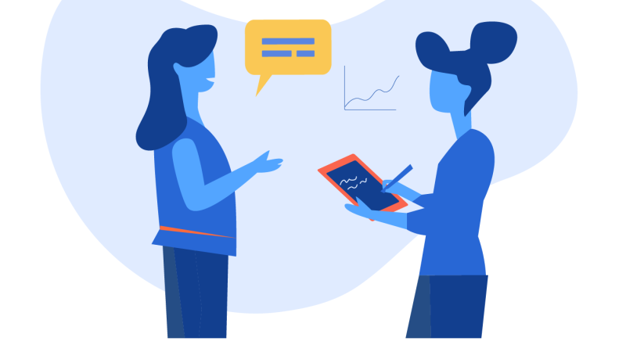
Personas

Slide 7
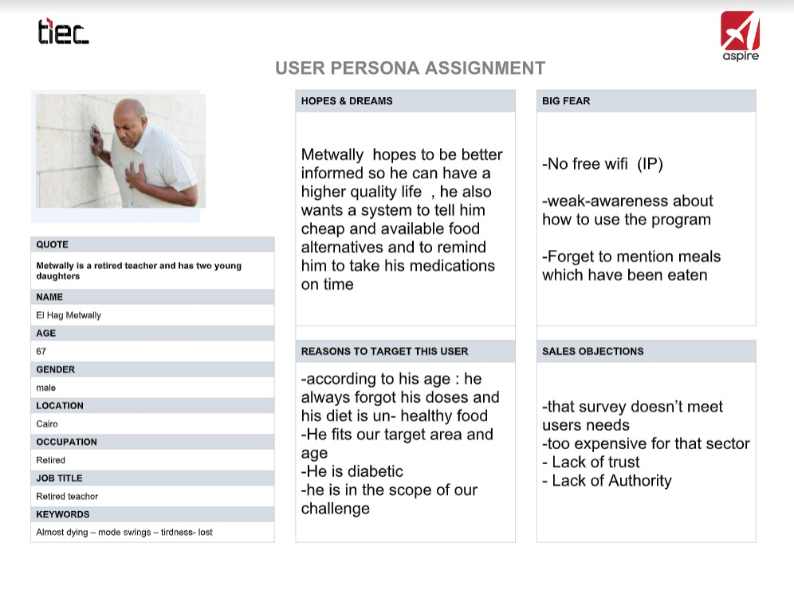

Slide 8
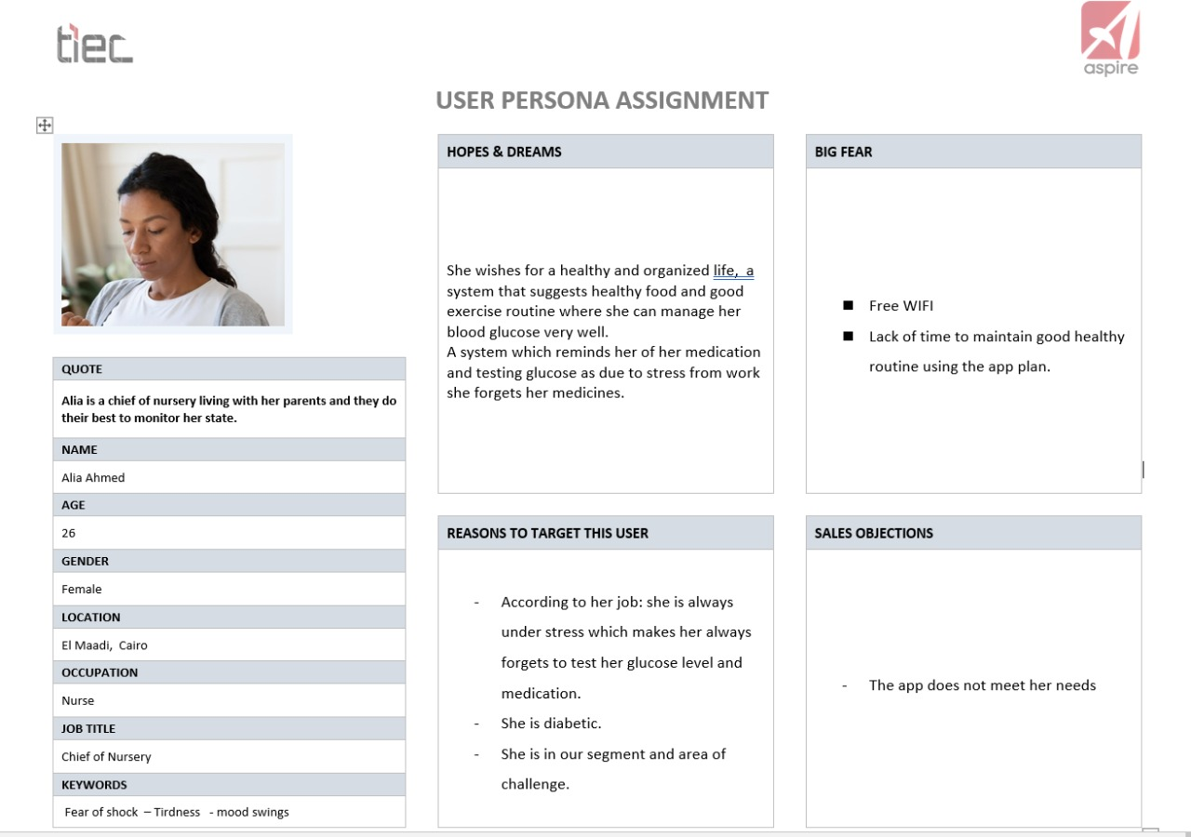

Slide 9
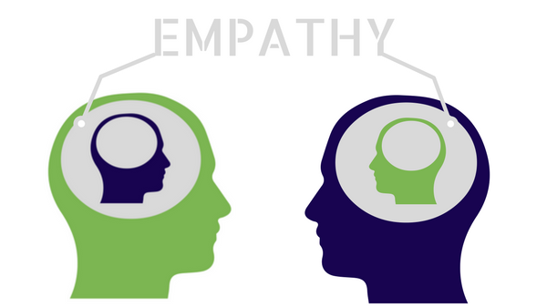
Empathy

Slide 10

Who are we helping with our solution?
We are helping diabetics who find it difficult to deal with diabetes.
Who are our stakeholder?
the stakeholder is the family of the diabetic.

Slide 11

How can we understand the needs of our users/ stakeholders?
We made an interviews with number of diabetics
we share a survey on different platforms to understand their suffering deeply.

Slide 12
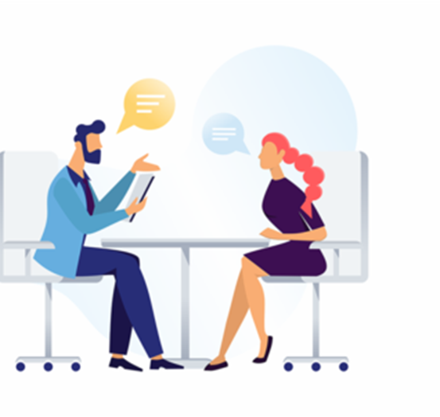
Interview:
1-What is the most annoying thing about being diabetic?
2- Do you need help to decide which meals to eat?
3-How do you manage the doses of medication?
4-Do you need someone to help you with that?
5- Do you think that by creating a diabetic community, there is something to support them?
6- Are you familiar with using technology?
7-Tell me a sad story that happened to you because of your disease?
8- Do you think kids need a survey like that?
9- Do you think our survey will fill a gap? 10- If you have the ability to add feature for this app what's the feature you think that will help them?

Slide 13
Empathy Map:
Think and feel:
- Is my condition that serious?
-I don't want to put a load on my family monitoring and organizing everything for me
- I can't enjoy my life that way
-I always feel weak
Hear:
-You are living in a mess, you always forget to take your medicine ?
-You have to make control over your food and activities
-Why you always in an emotional swings
See:
Seeing normal people doing their daily activities without feeling tired as him
As a child:seeing his friend eating and playing without an restrictions like him makes him feels bad-being .
Say or Do:
-Why am I feel fatigue?
-What can I do to improve my health?
-who is the right person to talk to?
-I don’t know what is the right for …?

Slide 14
Pain:
he wants to be healthy but he don’t know how to do that , he feels that there is not too many available food options for him which make him quietly depressed.
Gain:
he dreams for a better life style , someone to share him progress with or even his medical problems and stories to feel more home and inspired for a better life.

Slide 15
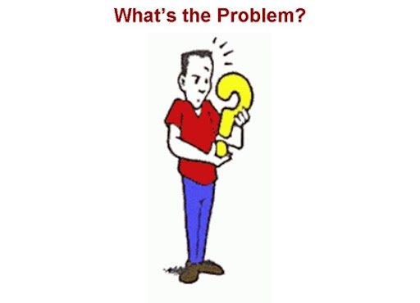
Problem Definition

Slide 16
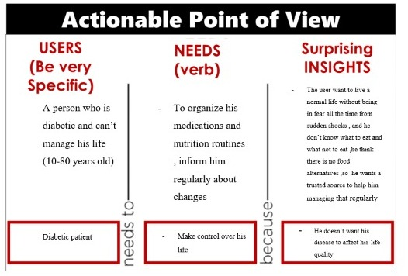

Slide 17
How might we?

Slide 18
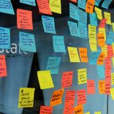
How might we?
Help them got supported ?
Be persistent and continue their treatment journey?
3)Rescue them in urgency ?
4)Help them strength their relation with healthy food ?
5)Help them feel belonging to a community to share feelings successful stories and advices ?
6) Got trusted consultations ?
7) Have a higher quality life ?
8) Make them stuck to a system?
9)Make control over the complications ?

Slide 19

Selected Idea

Slide 20
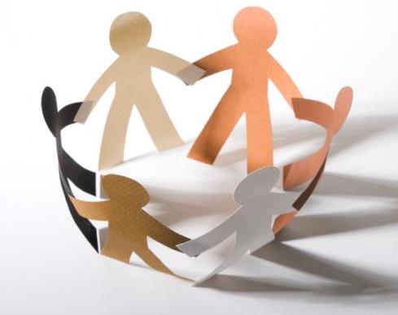
Selected Idea:
Introduce support for diabetics through a community where they could share their success stories and treatments.

Slide 21

Selected Idea:
Scheduling their medications , Offer nutrition systems depending on patients current health condition.

Slide 22
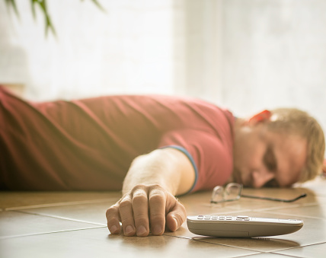
Selected Idea:
Notifying them to take their medications .
If they activate the safety option, the notification is repeated three times in case of no response and in the third time , the system notify one of his relatives with the patient location and the last measures the patient had entered in the application measurements .

Slide 23
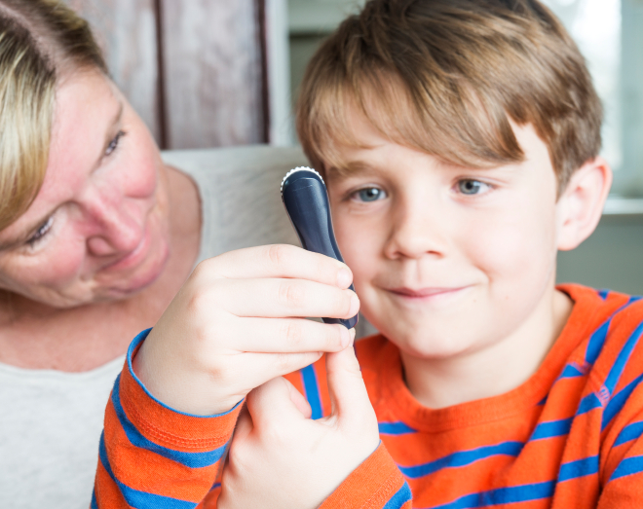
Selected Idea:
We make a special version for kids where diabetes is visualized as a friend to the kid that got happy and angry according to the kid condition , love taking insulin on time..
And the kid mission is to make his friend always satisfied

Slide 24
Technology Description

Slide 25
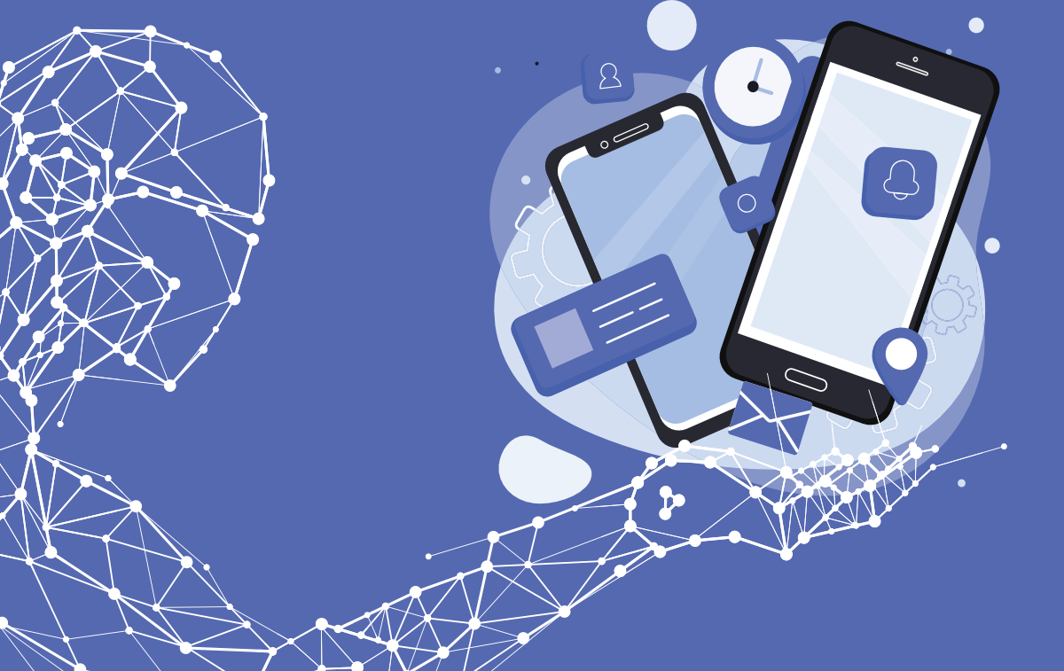
What are the tech components of the product?
we Make mobile application integrated with Artificial intelligence to introduce our serve.

Slide 26
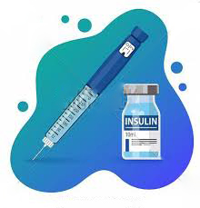


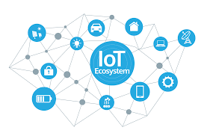
Explain the technical block diagram for your solution :
In the future

Slide 27
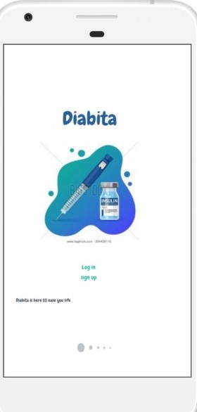
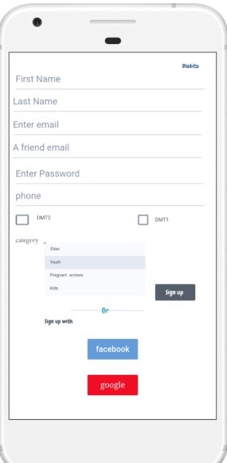
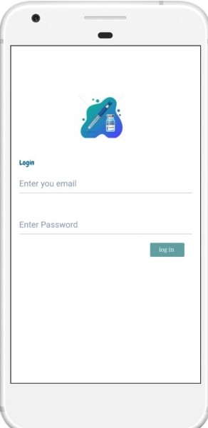
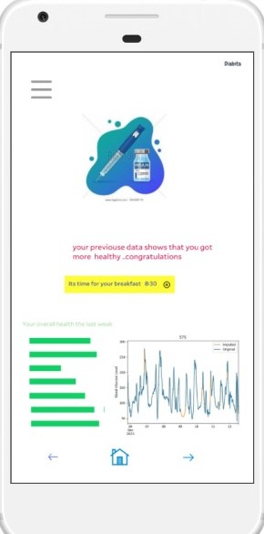
Prototype:

Slide 28
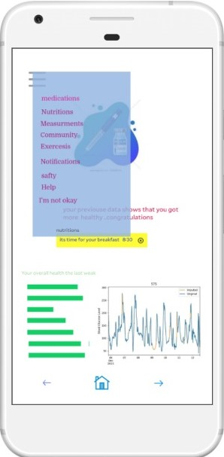
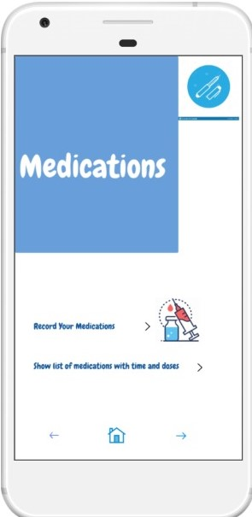
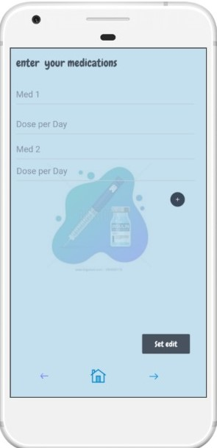
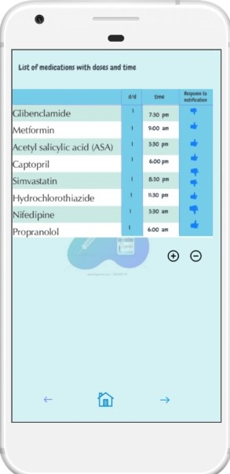
Prototype:

Slide 29
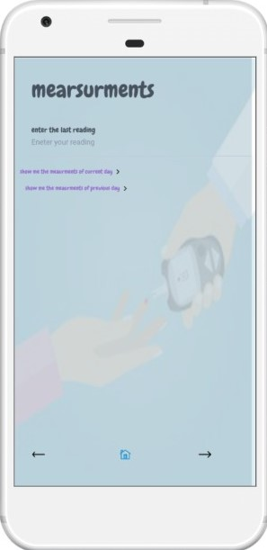
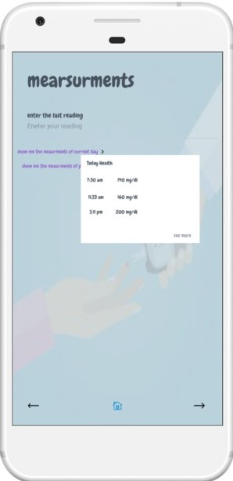
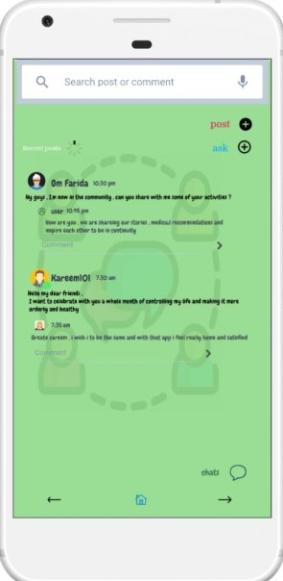
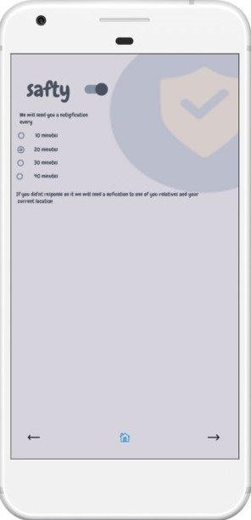
Prototype:

Slide 30
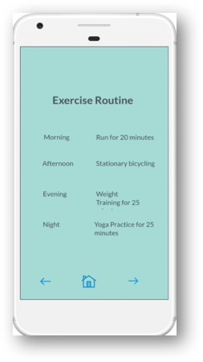
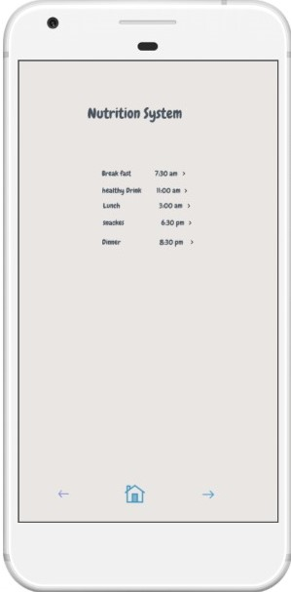
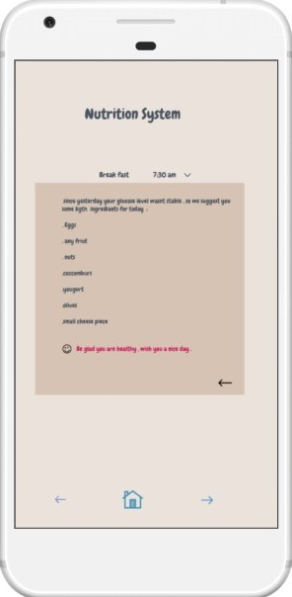
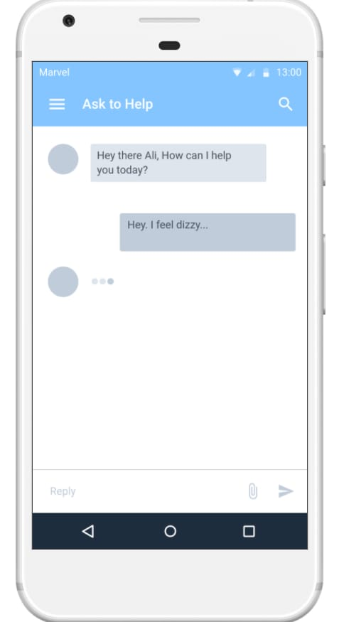
Prototype:

Slide 31
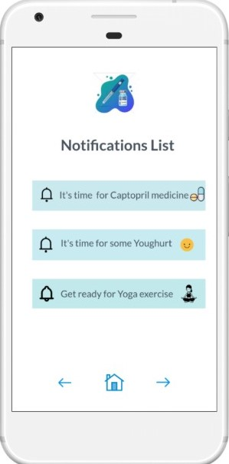
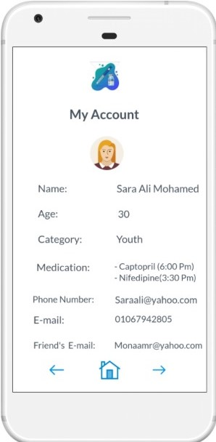
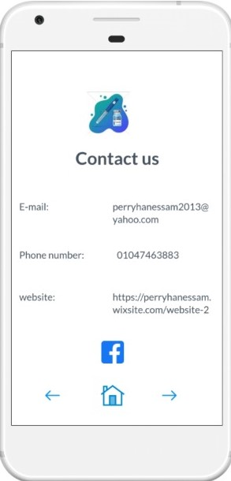
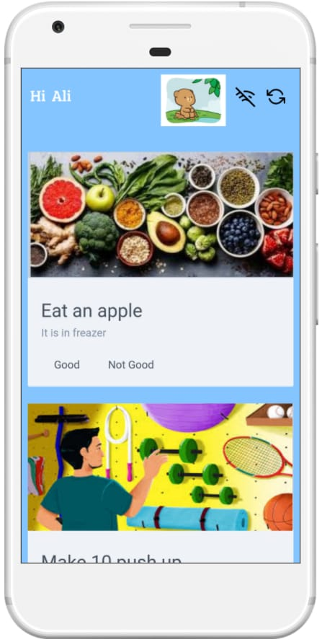
Prototype:

Slide 32
Value Proposition

Slide 33

Value proposition
1) Combining different features in one app which focuses on differentiation strategy
Ease the usability of app for the user to make him more familiar with it
Support him with trusted advices
Support the patient emotionally
Regulate him medication
Suggesting the proper nutrition System
notify his relative in case of Urgency
Visualize his previous health data
Building a version for kids where diabetes is visualized as a friend for the kid

Slide 34
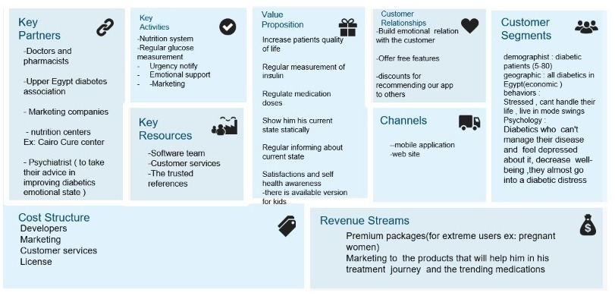
Business Model Canvas

Slide 35


Thank You

